Slide 1

Credit card report
The Kartik Analytics

Slide 2


Revenue Analysis & Customer Analysis

Slide 3

Project Objective
To develop a comprehensive credit card revenue and customer analysis dashboard that provides real-time insights into key performance metrics and trends, enabling stakeholders to monitor and analyze credit card operations effectively.

Slide 4
Insights
Highest revenue by card category [Blue card] 46.1M
Highest revenue by Profession [business man] 17.4M
Total interest 7.8M
Overall revenue 55.3M
Total transaction amount 45M
No. of Transaction 656k

Slide 5
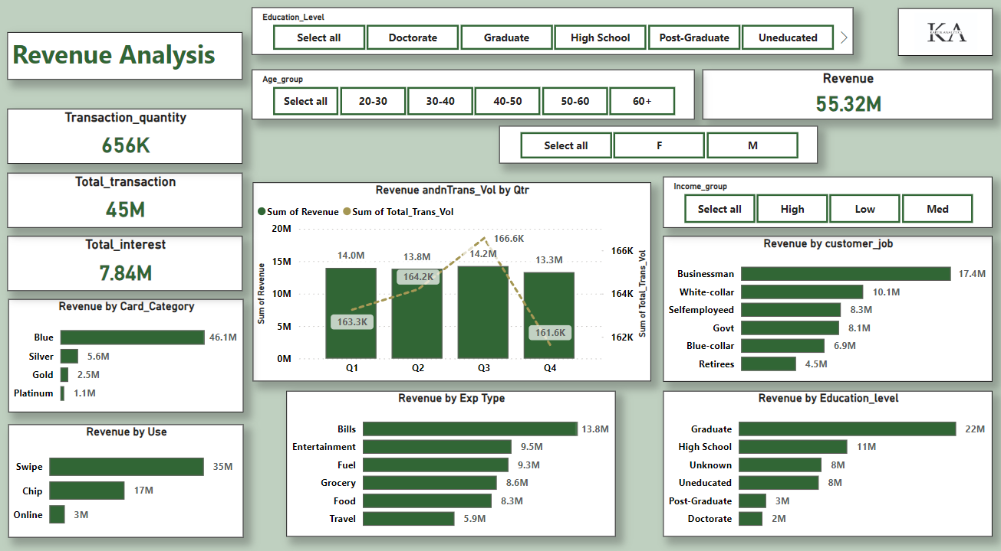
Dashboard1

Slide 6
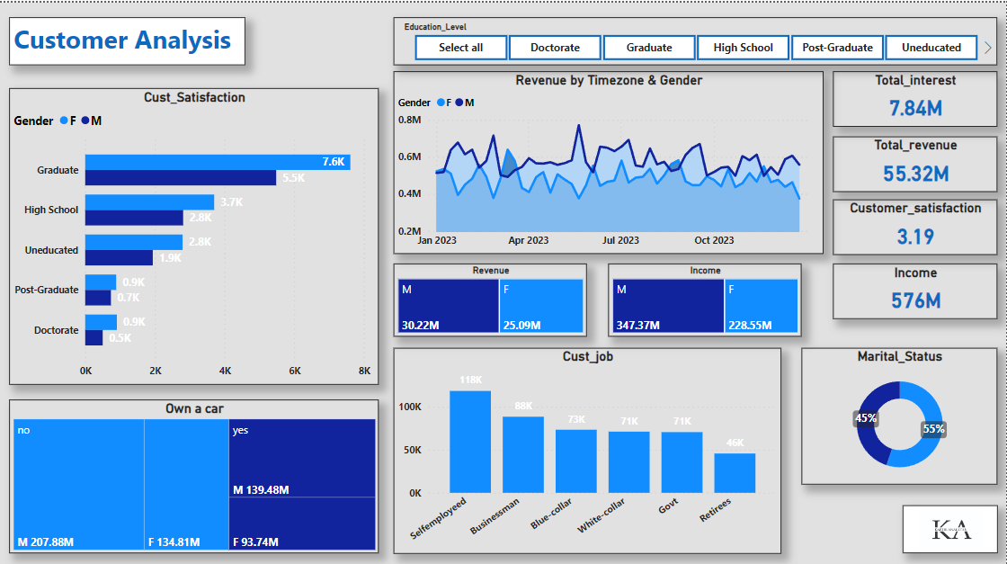
Dashboard2

Slide 7


SUMMARY
Total interest 7.8M
Overall revenue 55.3M
Average Customer Satisfaction rate 3.19
Total transaction amount 45M
No. of Transaction 656k
Male clients are more satisfied than females
Self employed clients owning more cards but Business men
are providing the highest revenue.

Slide 8
THANK YOU
The Kartik Analytics
Tharkartikanalytics21@gmail.com
Upadhyayk629@gmail.com

